Slide 1

CS589-04 Digital Image Processing
Lecture 9. Wavelet Transform
Spring 2008
New Mexico Tech

Slide 2
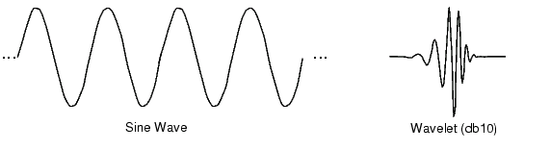
Wavelet Definition
“The wavelet transform is a tool that cuts up data, functions or operators into different frequency components, and then studies each component with a resolution matched to its scale”
Dr. Ingrid Daubechies, Lucent, Princeton U.

Slide 3
Fourier vs. Wavelet
FFT, basis functions: sinusoids
Wavelet transforms: small waves, called wavelet
FFT can only offer frequency information
Wavelet: frequency + temporal information
Fourier analysis doesn’t work well on discontinuous, “bursty” data
  music, video, power, earthquakes,…

Slide 4
Fourier vs. Wavelet
Fourier
  Loses time (location) coordinate completely
  Analyses the whole signal
  Short pieces lose “frequency” meaning
Wavelets
  Localized time-frequency analysis
  Short signal pieces also have significance
  Scale = Frequency band

Slide 5

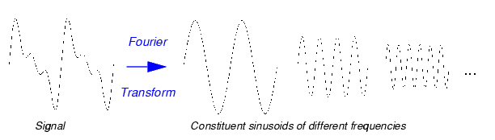
Fourier transform
Fourier transform:

Slide 6
Wavelet Transform
Scale and shift original waveform
Compare to a wavelet
Assign a coefficient of similarity

Slide 7
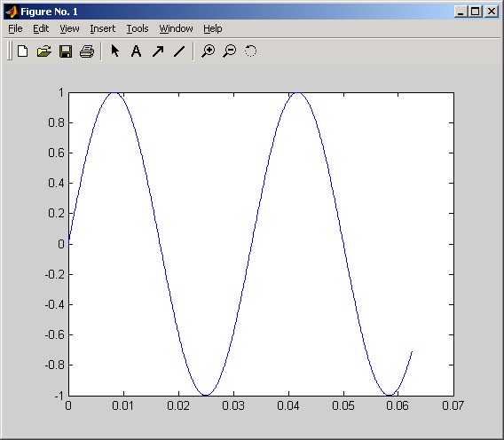
Scaling-- value of “stretch”
Scaling a wavelet simply means stretching (or compressing) it.
f(t) = sin(t)
scale factor1

Slide 8
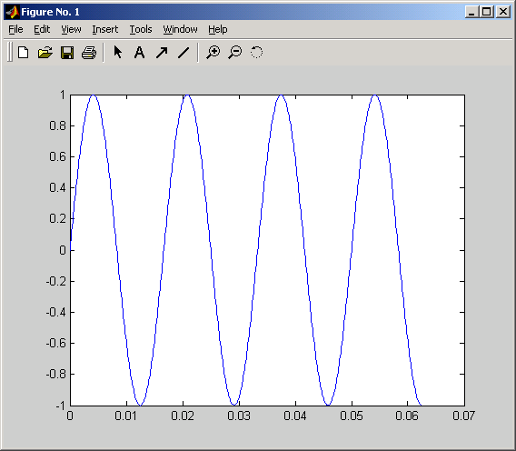
Scaling-- value of “stretch”
Scaling a wavelet simply means stretching (or compressing) it.
f(t) = sin(2t)
scale factor 2

Slide 9
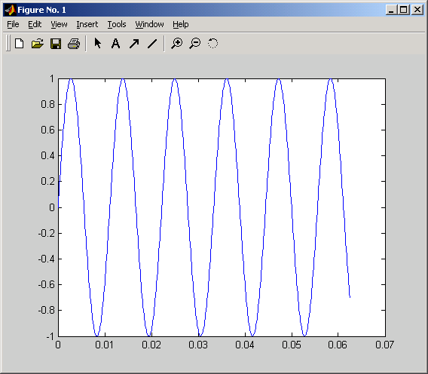
Scaling-- value of “stretch”
Scaling a wavelet simply means stretching (or compressing) it.
f(t) = sin(3t)
scale factor 3

Slide 10
More on scaling
It lets you either narrow down the frequency band of interest, or determine the frequency content in a narrower time interval
Scaling = frequency band
Good for non-stationary data
Low scale→a Compressed wavelet→ Rapidly changing details→High frequency
High scale →a Stretched wavelet → Slowly changing, coarse features → Low frequency

Slide 11
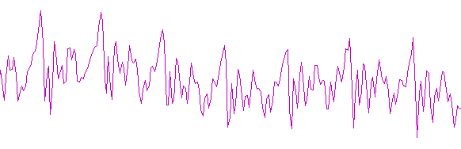
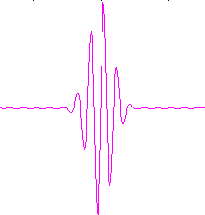
Scale is (sort of) like frequency
Small scale
-Rapidly changing details,
-Like high frequency
Large scale
-Slowly changing
details
-Like low frequency

Slide 12
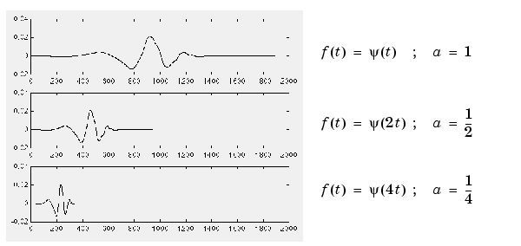
Scale is (sort of) like frequency
The scale factor works exactly the same with wavelets. The smaller the scale factor, the more "compressed" the wavelet.

Slide 13
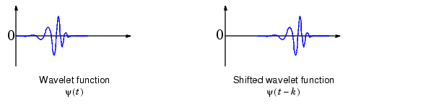
Shifting
Shifting a wavelet simply means delaying (or hastening) its onset. Mathematically, delaying a function f(t) by k is represented by f(t-k)

Slide 14
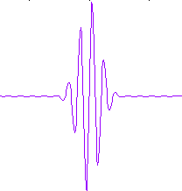
Shifting
C = 0.0004
C = 0.0034

Slide 15
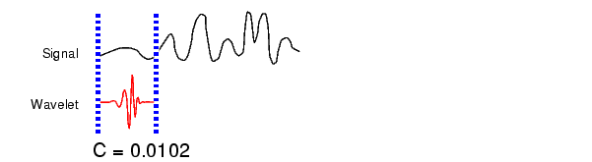
Five Easy Steps to a Continuous Wavelet Transform
  Take a wavelet and compare it to a section at the start of the original signal.
  Calculate a correlation coefficient c

Slide 16
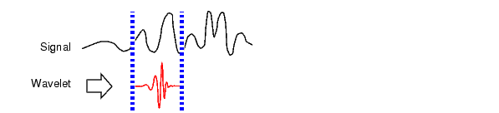
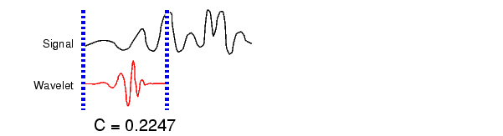
Five Easy Steps to a Continuous Wavelet Transform
3. Shift the wavelet to the right and repeat steps 1 and 2 until you've covered the whole signal.
  4. Scale (stretch) the wavelet and repeat steps 1 through 3.
  5. Repeat steps 1 through 4 for all scales.

Slide 17
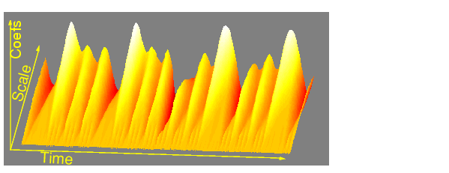
Coefficient Plots

Slide 18
Discrete Wavelet Transform
“Subset” of scale and position based on power of two
  rather than every “possible” set of scale and position in continuous wavelet transform
Behaves like a filter bank: signal in, coefficients out
Down-sampling necessary
(twice as much data as original signal)

Slide 19
Discrete Wavelet transform
signal
lowpass
highpass
filters
Approximation
(a)
Details
(d)

Slide 20
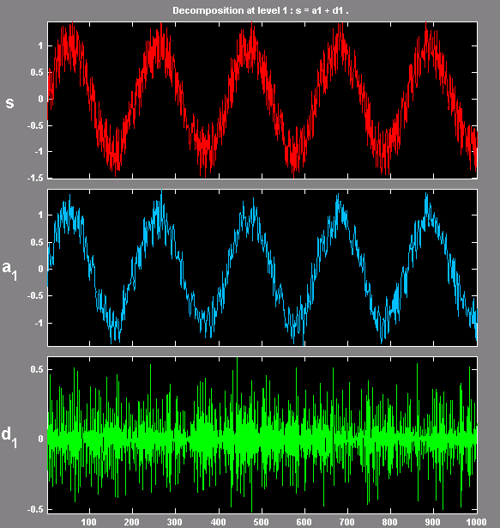
Results of wavelet transform
— approximation and details
Low frequency:
  approximation (a)
High frequency
  details (d)
“Decomposition”
can be performed
iteratively

Slide 21
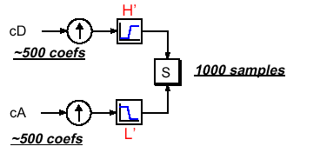
Wavelet synthesis
Re-creates signal from coefficients
Up-sampling required

Slide 22
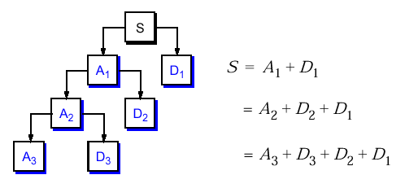
Multi-level Wavelet Analysis
Multi-level wavelet decomposition tree
Reassembling original signal

Slide 23
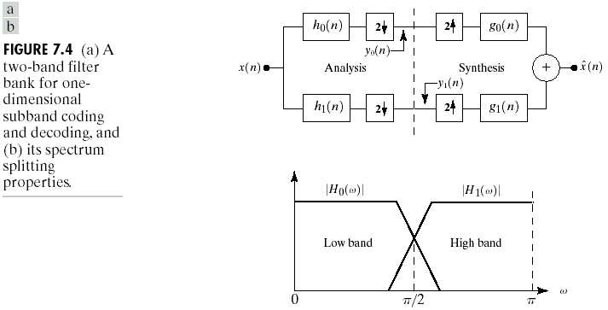
Subband Coding

Slide 24
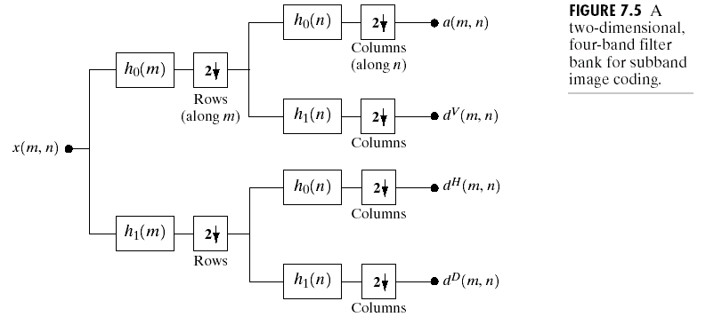
2-D 4-band filter bank
Approximation
Vertical detail
Horizontal detail
Diagonal details

Slide 25
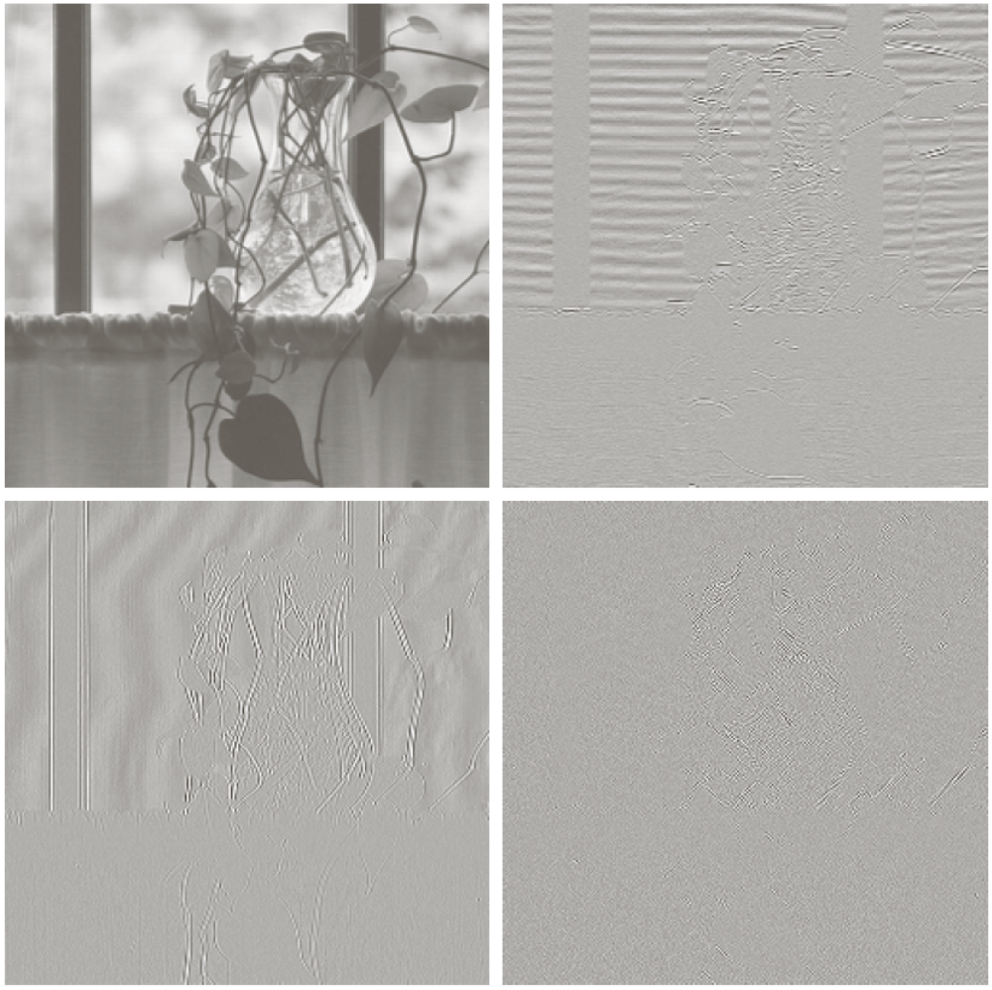
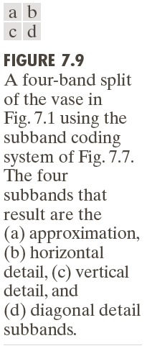
An Example of One-level Decomposition

Slide 26
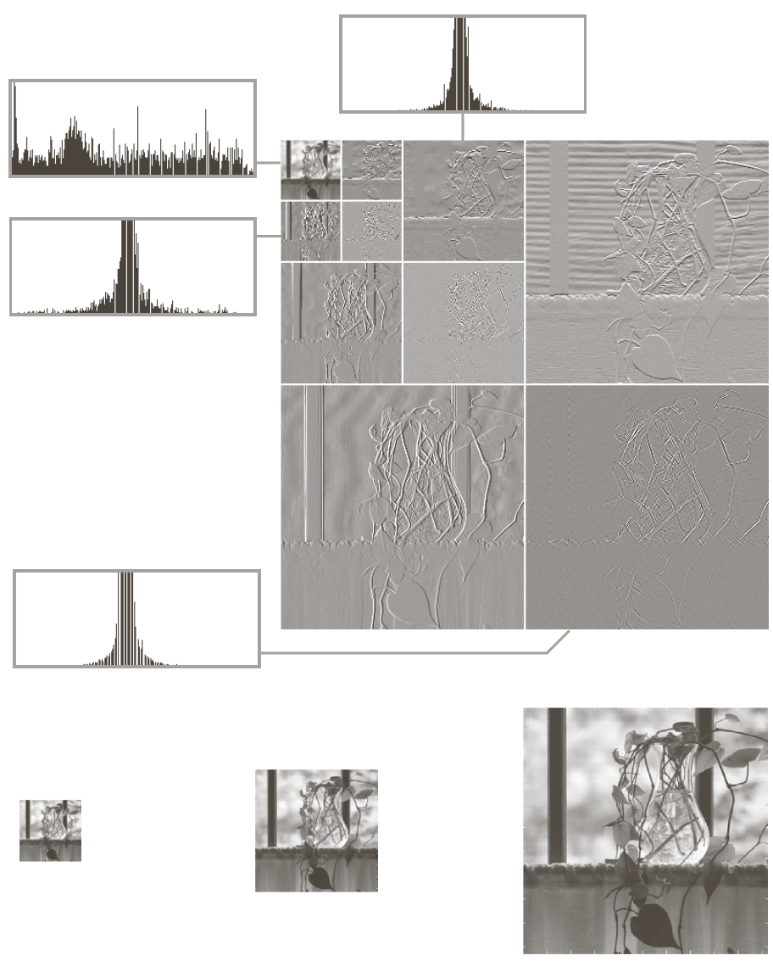
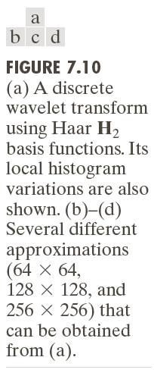
An Example of Multi-level Decomposition

Slide 27
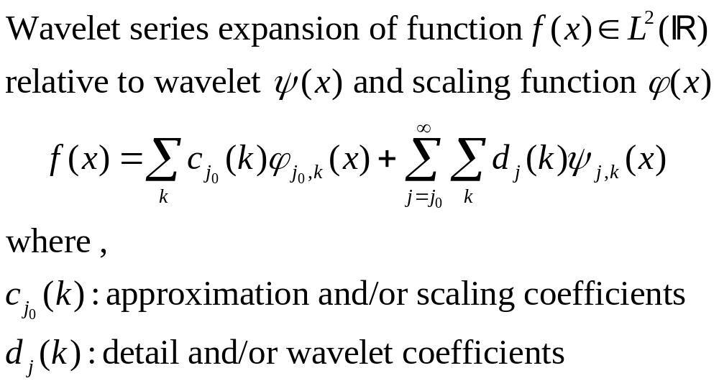
Wavelet Series Expansions

Slide 28
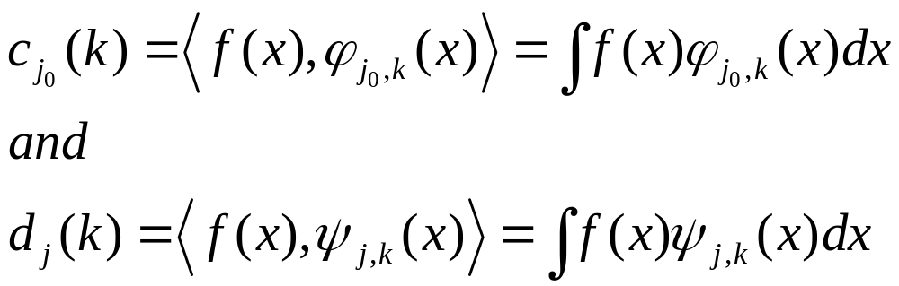
Wavelet Series Expansions

Slide 29
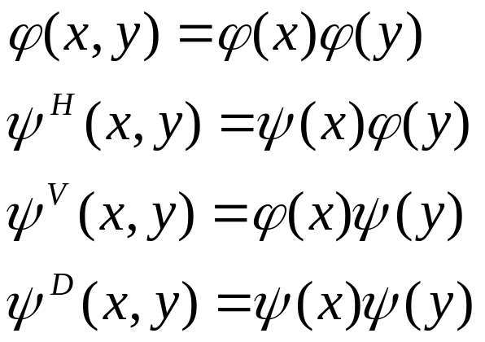
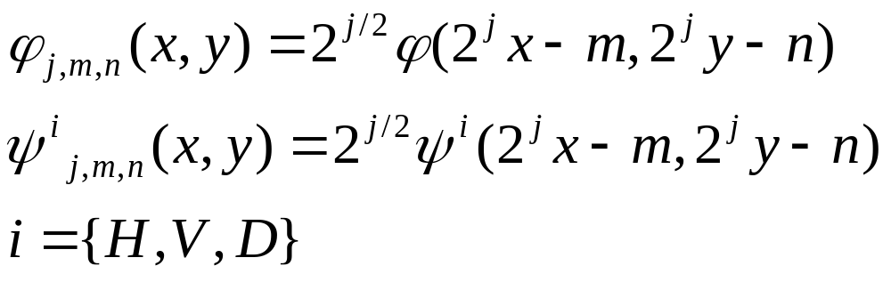
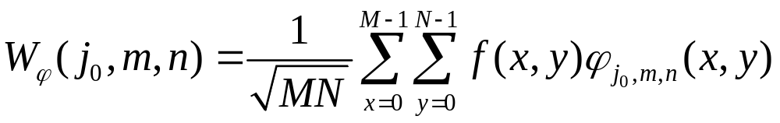
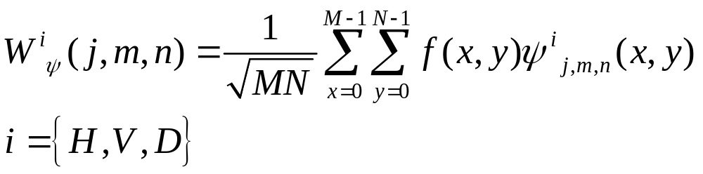
Wavelet Transforms in Two Dimensions

Slide 30
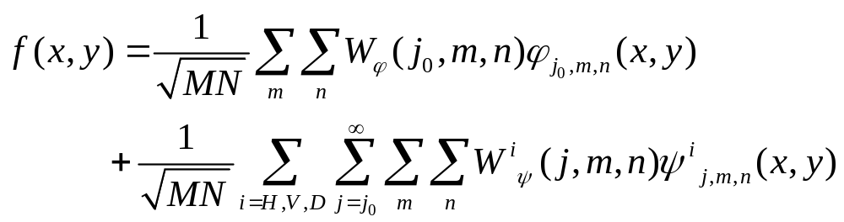
Inverse Wavelet Transforms in Two Dimensions

